Slide 1
“Who will stay home today?”
What do we know…
What do we need to know about parental sharing of leave to care for sick children?
Linda Haas, Indiana University, USA
Philip Hwang, University of Gothenburg, Sweden
Annual Meeting of the Network for Leave Policies and Related Research, 2016, Madrid

Slide 2
Outline
• Why study fathers’ use of leave to care for sick children?
• What do we know about fathers’ right to leave to care for sick children?
  Findings from a 2015 Swedish study
• What future research is called for?

Slide 3
Why study fathers’ use of leave to care for sick children?
Unlike parental leave:
  Doesn’t typically interfere with breastfeeding
  Fathers home alone ➔builds skills
  Requires intensive nurturing ➔builds skills
  Cannot be planned ahead
Like parental leave:
  Challenges gendered assumptions about work and caregiving
  Might promote shared division of labor
  Promotes strong father-child relations
  Could reduce discrimination against mothers

Slide 4
What do we know about fathers’ leave to care for sick children?
EU directive entitles fathers to time off
12 EU countries offer fathers at least 10 days with pay per year (+4 non-EU), 4 EU states offer leave without pay
Taken more than parental leave
(e.g., Swedish fathers take 38% of sick leave leave days, 25% of parental leave days)
No upward trend (Finland and Sweden)
Taken less when partner’s income is low, when he works in private sector

Slide 5
2014 Swedish Study of White-Collar Fathers in Private Sector (N=1,344)
Telephone survey, 56% response rate
Conducted by Novus of Unionen members (largest union)
34% were managers
74% took turns being home with partner
Overall finding:
**Worklife was “boundary-less” – when fathers were home with sick children, many continued working and experienced stress

Slide 6
Two ways fathers were at home:
VABBNING = benefit
• 84% fathers
• 47% could not detach themselves from work
• 43% worked at home to reduce workload
• 38% felt stressed about work when home
• 27% bad conscience because not at work
VOBBNING = no benefit
• 40% fathers (always/often)
• reasons:
time pressure
co-worker loyalty
specialization
• 35% said they were not “there” for their children
• 31% would like to not “vobba”

Slide 7
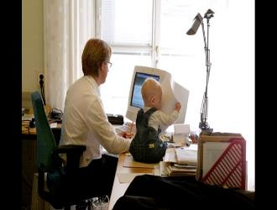
Conclusion?
Policy is good but…
• White-collar fathers
pressured to prioritize work
even when home, by work Picture from Radio Sweden 14/2/14
culture norms, work intensification, technology
• How can policies promote fathers disconnecting from work to do childcare?
• What research on fathers’ use of leave to care for sick children is needed?

