Slide 1
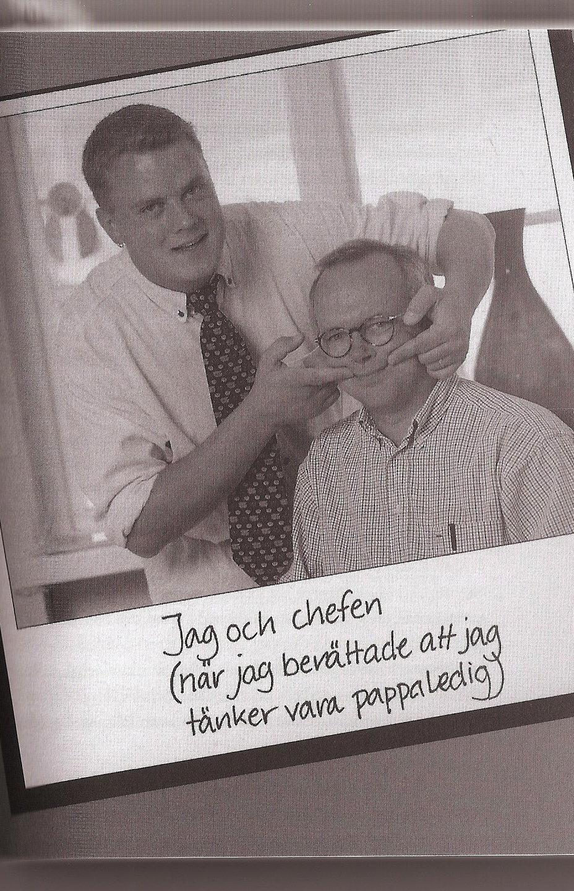
“Taking pappa leave?
Great!
How will your job get done??”

Slide 2
Companies' gradual accommodation of caregiving fathers in Sweden
Update on research by:
Linda Haas, Indiana University
C. Philip Hwang, University of Gothenburg
Research funded by the Swedish Council for Working Life and Social Research

Slide 3
Fathers’ leave use
Fathers use only 24% of days available to couples
91 days for fathers vs 342 days for mothers
Only 12% of couples share equitably (60/40)

Slide 4
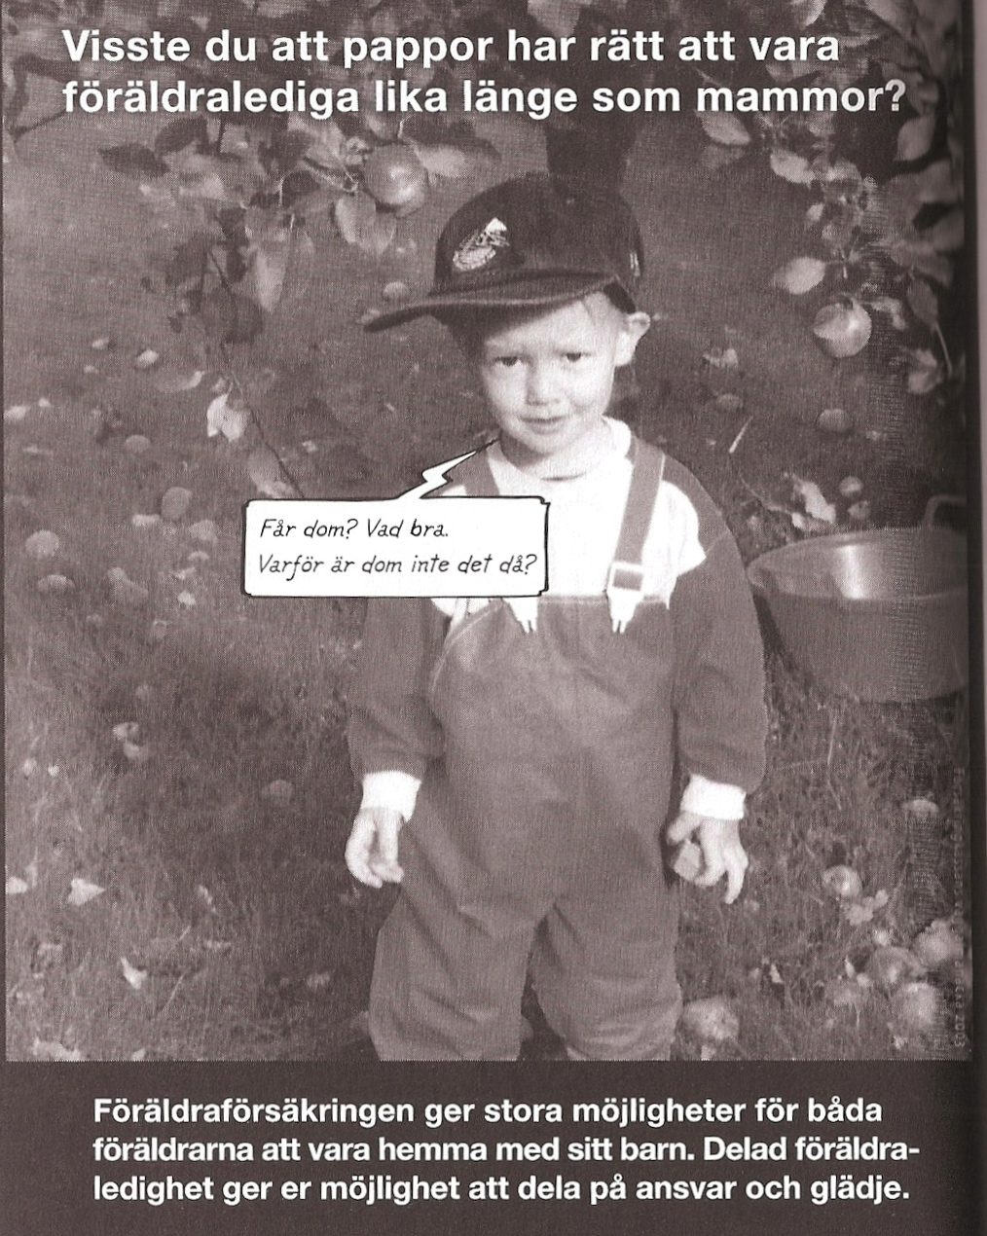
Why a gender gap?
• Family finances
• Parents’ preferences
• Lack of political support for equality
• Lack of workplace support (especially private sector)

Slide 5
Previous survey research (2006)
In only 15% of companies did majority (60%+) of fathers take 2 pappa months
Increasing formal and informal support for fathers’ leavetaking, but majority of companies not supportive

Slide 6
Case study research goals
• to discover what policies and practices embedded in corporate culture and structure facilitate or hinder fathers’ leavetaking
• to explore transition from corporate “accommodation” to “transformation”

Slide 7
Companies studied
5 large, male-dominated companies with a range of father leave use (in 2006 survey)
Blue-collar & white-collar workers
Manufacturing (3), service (1), retail (1) in core industries
Swedish-owned & headquartered

Slide 8
Companies in the Swedish context
  • Equality policy & leave legislation
  • Cultural discourse on fatherhood
  • Concern about public image
  • Value retention & productivity
  • Well-trained personnel with job security
  • Co-determination law
  • Strong sense of worker solidarity

Slide 9
Study participants in 5 companies
Two top managers
(1 HR)
White-collar middle manager
Focus group
3-5 white-collar fathers in work group
Blue-collar middle manager
Focus group
3-5 blue-collar fathers in work group
56 informants (“chain”)

Slide 10
Methods
Workplace interviews - 1-1.5 hours
6 hypothetical vignettes + 9 questions
Taped, transcribed (179 pages)
Respondents interested in discussing topic
Hybrid thematic analysis

Slide 11
Reactions to interviews
People almost never talk about parental leave, not like this. It’s more like we congratulate new fathers and check out the child if they come and visit, but discussing different problems or what would be good? No. (WC Manager in FF co.)
This is so interesting! I didn’t really think that it would be fun to answer questions about this, but I notice that I have become quite engaged in our discussion - it is of course about our children! (BC father in NF co.)

Slide 12
Theoretical frameworks
Gender theory – to understand resistance
Workplace is a gendered social institution ~
  organized around a “male model of work”
  discounts men’s caregiving responsibilities
  rewards visible time at work

Slide 13
Theoretical frameworks
  Organizational learning theory – to understand change
  Organizations respond to challenges through
  • Gaining knowledge and developing skills
  • Balancing established routines with exploring new opportunities
  • Recognizing short-term and long-term benefits to individuals and companies

Slide 14
Research topics explored
Employer attitude/mode of learning
Rationales for support
Strategies for handling work, supporting fathers
Negative and positive outcomes
Barriers and facilitators
Change drivers

Slide 15
I am careful not to sigh, while thinking, God, how difficult! You want to be at home now, too?!
No, I am careful and say instead, ”Cool, we will see how we can solve this. Have you some suggestions?”
I usually try to encourage them to come up with solutions about who we should bring in or move around.
They know each other so well so that they know who functions best together.
– Blue-collar manager, FF co.

Slide 18
Outcomes
Negative – threaten profits:
Lost competence
Work undone
Makes teamwork difficult
Overburdens co-workers
Requires too much collaboration
Positive – enhance profits:
Attractive workplace
Shows employee care (>retention, productivity)
“New blood” in teams
Company learns flexibility
New opportunities for co-workers
“New powers” for fathers

Slide 19
Barriers to transformation
Economic
Cultural:
• Assume policy is enough
• Lack of leadership
• Lack of managerial role models
• Lack of cultural discourse
• Gendered beliefs & norms
Work practices:
• Structural indispensability
• High job interdependence
• No age mix on teams
• Rapid work pace/demanding jobs
• Lack of managerial training, incentives

Slide 20
Facilitators of transformation
Economic
Cultural:
High commitment to employees
Strong approval for active fatherhood
Solution-focused
Atmosphere of solidarity & trust
Highly adaptive to change
Worker flexibility
Managerial role models
Work practices:
Results-focused
High managerial discretion
Self-managed work-teams
Cross-training in place

Slide 21
Change drivers
Changing demographics of workers, managers
Cultural discourse about fatherhood
Recognition of economic benefits of more flexible ways of working

Slide 22
What government could do
Encourage companies’ auditing and monitoring of progress
Offer companies training and guidance on implementation
Provide financial support for within-company training and implementation
Certify and award best company practices
Tackle prevailing societal gender norms regarding employment and caregiving

