Slide 1
Southern European revision of leave policies in the last decade
(Greece, Italy, Spain and Portugal)
Anna Escobedo, University of Barcelona & Karin Wall, University of Lisbon
10th LPR Network seminar,
Paris, 17-18 October 2013
Session 3. Reviewing the past decade: leave policies in a welfare state and family policy context – Regional perspectives

Slide 2
Contents
The concept of ‘Leave models’ as analytical tool
Work and family patterns (relevant indicators, commonalities and differences in the 4 countries)
Leave and childcare policies (pathways and turning points, relevant actors)
Meanings of the crisis: relevant topics and trends in the 4 countries since 2008
Discussion:
How have evolved the ‘short-leave modified male breadwinner model’ and the ‘early return to full-time work gender-equality oriented leave model’?
In which aspects are the 4 countries converging or diverging? Are they approaching to other groups?

Slide 3
‘Leave models’
Refer to specific configurations of leave institutions, culture and social actors and their complex interrelationships
Emerge both at a national or cross-national level.
Dynamic - include processes and pathways of change and transformation
We need a conceptual framework which bridges the gap between welfare regime analysis and country/case-level analysis, to understand the changing nature and diversity in parental leave policies and childcare systems.

Slide 4
UNDERLYING RESEARCH QUESTIONS:
How are family and gender models evolving? Shift away from male breadwinner model?
Cross-national convergence? Maintenance or increase in divergence?
Welfare state analysis does not account enough for variation of leave systems: What else is shaping diversity?

Slide 5
Leave models have four main DIMENSIONS:
LEAVE SYSTEMS (duration and type of leave, payment, degree of individualisation such as father’s specific entitlements, practices – take-up rates.)
OBJECTIVES AND ORIENTATION OF LEAVE POLICY OVER TIME: gender equity, work-family balance, family-building (motherhood/fatherhood), child development and well-being
GENDER-WORK-FAMILY models and practices: conjugal divison of paid and unpaid work (ideals and practices of parental care and roles)
EARLY EDUCATION AND CARE SERVICES (intensity and prevalence). Welfare regime and CARING when parents work: care as the task of the family, state, market, third sector

Slide 6
Combining these dimensions, we identified 7 leave models in contemporary European societies, reviewing indicators and data from the Annual Reviews of the International Network on Leave Policies and Research 2005-2013, OECD Family Database and Eurostat, in 22 European Countries:
1) The “one year leave” gender equality oriented model (Sweden, Iceland, Denmark, Slovenia )
2) The long leave “parental choice oriented” model (Finland, France, Norway, Belgium)
3) Long leave “mother home-centred” model (Hungary, Czech Republic, Estonia, Poland)
4) The “balanced” mother-home-centred model (Germany, Austria)
5) Short leave “part-time mother” model (United Kingdom, Netherlands, Ireland)
6) Short leave modified “male breadwinner” model (Spain, Italy, Greece)
7) The “Early Return to Full-time Work” Leave Model (Portugal)

Slide 7
6) Short leave modified “male breadwinner” model
Main Characteristics: Greece, Italy and Spain
One main type of leave: maternity, short (4 months), very well paid (80-100%) with improved coverage
Weak but development of parental leave (low benefits 30%, working time reductions that can be taken in a block, public sector improvements, sectoral & regional variation… )
Low integration of leave and services system (low to above average availability of services < 3 years, regional variation, more complementary relation in Spain)
Emerging emphasis on gender equality (particularly in Spain)
Maternal employment rate between 2-10 p.p. below EU average when children are small (female employment more affected by educational attainment and historical cohort, than by age of the child). Male unemployment and casualisation is stimulating high female activity rate.
Dual earner model is now predominant (female part-time is near average in Italy, below average in Spain and low in Greece)

Slide 8
7) The “Early Return to Full-time Work” Leave Model (Portugal)
Main Characteristics:
One main type of leave: a short, very well-paid, gender flexible leave, up to five and a half months;
Supporting work/family balance during first year child’s life through reduction in working hours (two hours per day, either parent);
Emphasis on gender equality (gender sharing and father’s entitlements)
Complementary relationship between leave and services: access to services as leave ends to support dual-earner model;
High female activity rate (full-time) + predominant model of full-time dual-earner couple;

Slide 9
Countries | Maternity Leave | € | Paternity Leave (during mat. leave) | € | Parental Leave |  |  | Total Post-Natal Paid Leave
 |  |  |  |  | Total length | € | Who in fam.
Italy | 5 months (1 before) | 80% -100% | 1 day | 100% | 10 months | 30% | 6 per parent (max 10) | 14 months (4 mths: 80%)
Greece Pub. Sector | 5 months (2 before) | 100% | No specific entitlement | - | 48 mths 9 mths | Unpaid (if => 3rd child 3 mths paid) 100% | 24 mth per parent Per family | 12 months (100%)
Greece Priv. Sector | 4 months ( 2 before) + 6 mths (special leave) | 100% Paid by employer min.wage | 2 days paid by employer | 100% | 8 months 3,75 months (if employer agrees) | Unpaid Paid 100% by Manpower Organisation (Alternative use of reduced hours) | 4 mths per parent 3,75 months x family | 12 months (5,75 mths: 100%)
Spain | 4 months + 2-4 weeks | 100% max. € 3230/ mth | 15 days | 100% max. € 3230/ mth | Up to 36 months per parent (until chid is 3) | Unpaid (flat rate in some regions per family under conditions) |  | 4 -5 months (100% with ceiling)
Portugal | 5 months + 1 month bonus if gender sharing (“daddy month”) | 80% (or 4+1 at 100%) | 20 days (10 compulsory) | 100% | 6 months: + 24 mths special leave | 25% unpaid | 3 mths x parent x family | 12 months (5-6 mth: 80%)
1 month = 4 weeks; 1 year = 52 weeks; 1 month = 30 days; 1 week = 7 days

Slide 10
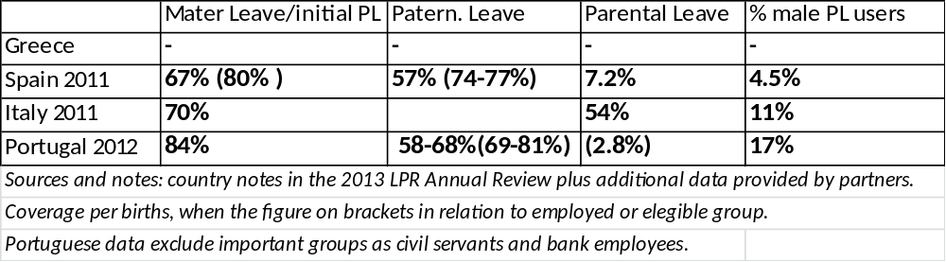
Table. Take up rates of maternity leave, paternity leave and Parental Leave in relation to births of the year 2011-12

Slide 11
Leave policy pathways in the 4 countries (relevant evolutions)
Positive impacts of the EU directives and comparative policy evaluation methods
Leave policies and childcare gain positions in the national policy agendas
In parallel to childcare services developments, increased perception of the need to articulate services and leaves (in Pt and ES; It? Gr?)
Gender equality discourses and emerging social policies of fatherhood (in Pt and ES; It? Gr?)

Slide 12
Leave policy turning points in the 4 countries
Portugal: 2004 obligatory paternity leave– 2009 paradigm shift with global reform
Spain: 2000 (regional diversification) , 2003 tax benefits for mothers staying at work, 2007 (relocation in gender equality law, with paternity leave extension and extension of leave+allowances for dependants), 2011-12 austerity measures
Italy (introduction 30% payment, 2013 introduction of compulsory paternity leave)
Greece (development in the provision of reduced working hours or in blocks of time first 1999 in the public then in private sector in 2004; 2008 special extension of maternity leave in private sector, 2012 austerity measures affecting collective bargaining)
Relevant actors:
Trade unions
State feminists
Regions (in Spain)
The public sector as employer (in Greece, in Spain)
The European Union (Parental leave directives, childcare recommendations, Employment and gender equality strategies...)

Slide 13
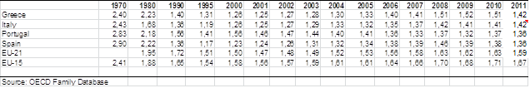
Relevant indicators
Fertility is clearly below EU average, slight recoveries in some years, now decreasing number of births from 2008 (particularly from 2012)

Slide 14
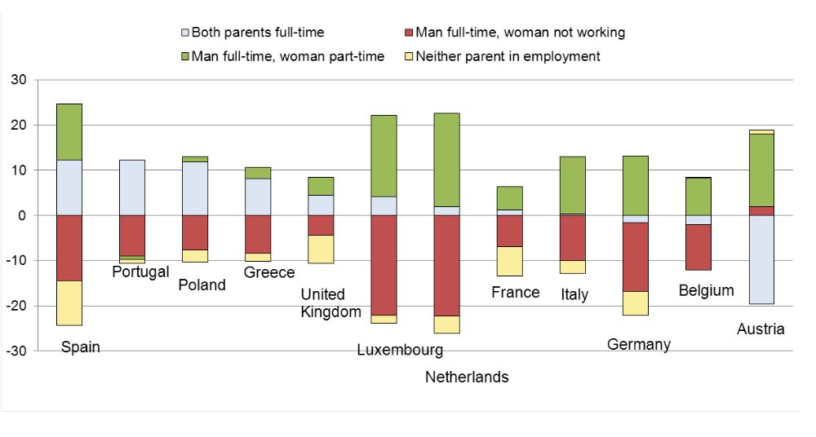
Chart. Change in the distribution of employment status among couple households from 1994 to 2008 in selected countries (Source: OECD Family Database LMF2.2.B Chart)

Slide 15
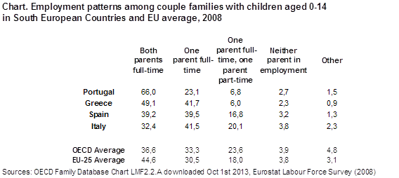

Slide 16
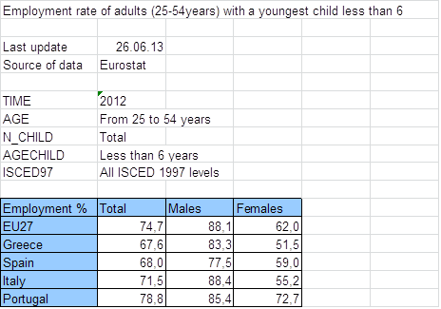

Slide 17
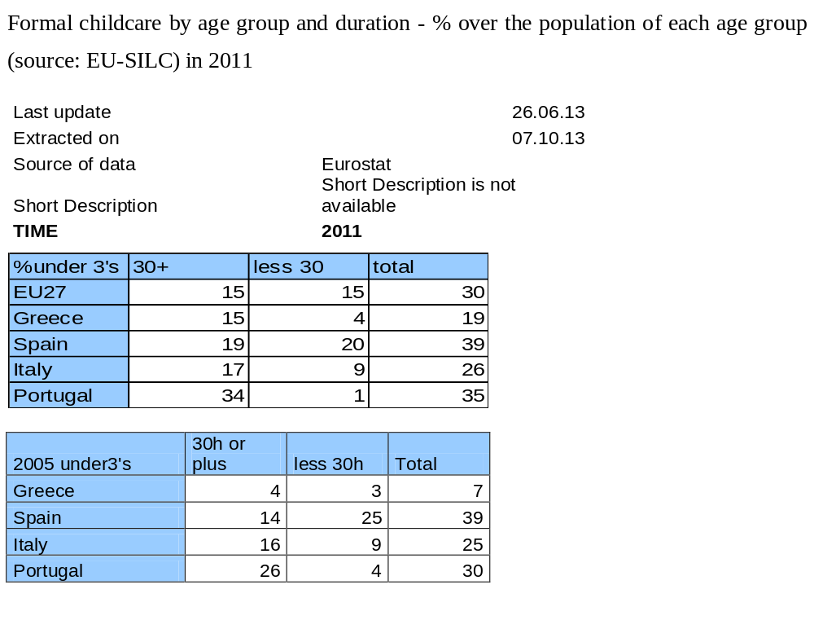

Slide 18
Conclusions (1)
In the last decade Southern European countries have shifted away from the male-breadwinner reference, both in terms of household patterns and policy models.
The new dominant pattern for families with children is the dual earner household connected both to early education and care services and to informal care arrangements within the extended family networks or the informal market.
Portugal has consolidated its differential trajectory with a policy model more adapted to its high rates of full-time dual earning.
The crisis in recent years is further deteriorating the male breadwinner model , meaning the activation of women (particularly adult women in central ages) and worst working conditions for all women and men. Plus migration issues.
Work-family-childcare policies had improved in the last decade (influenced by EU and international trends) Important development of formal childcare
Formally the improved leave systems remain intact up to date (take up rates patterns high for those entitled with less users due to fertility and eligibility decline)
Cuts in family policies are focusing on child benefits (increase of child poverty)
Focus on fathers: amongst those entitled, more use and improved gender sharing observed in Portugal and Spain, where data is available.

Slide 19
Conclusions (2)
The previous “rudimentary” leave systems have improved in the 4 countries in the last decade, while Portugal has produced a paradigm shift:
- Improvement of the maternity leave - Better coverage (including low paid schemes for employed mothers not reaching contributory payment requirements)
- Paternity leave granted (except in the Greek public sector, last in 2013 Italy)
- Movement away from unpaid parental leave schemes
- Extension of reduced working hours with the possibility/trend of alternative full-time options to extend paid leave
Resulting in improved take-up rates, when measures and data are available.
Early Childhood Education and Care (ECEC) services have developed in the four countries (rather than informal migrant household assistant solutions, more frequently related to elderly care?) articulating a complementary relationship in Portugal and Spain.

Slide 20
Conclusions (3)
Finally from research perspective
Data gaps have been improved in Portugal, Spain and Italy -to some extent-, remaining a difficulty for monitoring Greece (where data started to be collected 2 years ago by labour inspectors)
Is male unemployment and casualization shaping new work-family arrangements? New patterns of allocation of time involving redistributions of childcare and domestic tasks?
How will emerging low parental leave payments affect gender sharing in this group of countries?
Portugal clearly consolidates a divergent pattern.
But which label would be appropriate for the rest of the group ?

Slide 21
References
Addabo, T. &Giovannini, D. ‘Italy country note’
Escobedo, A. & Meil, G. ‘Spain country note’
Hatzivarnava, E. & Karamesini, M. ‘Greece country note’
Wall, K. & Leitao, M. ‘Portugal country note’
in: P. Moss (ed.) (2013)International Review of Leave Policies and Research 2013. Available at: http://www.leavenetwork.org/lp_and_r_reports/
Wall, Karin, Escobedo, Anna (2013). Parental leave policies, gender equity and family well-being in Europe. In Moreno Minguez, Almudena. (Eds.), Family well-being: European perspectives (pp. 103-130). [London]: Social Indicators Research Series, Springer.
Other data and indicators from:
http://www.oecd.org/els/soc/oecdfamilydatabase.htm
http://epp.eurostat.ec.europa.eu/portal/page/portal/employment_social_policy_equality/equality/indicators_gender
We are grateful to all criticism and comments received before, during and after the presentation , particularly from colleagues from Southern European countries. Following these comments, we have tintroduced some revisions to this presentation.

Slide 22
Thanks for your attention
anna.escobedo@ub.edu
karin.wall@ics.ul.pt

Slide 23
